Slide 1
Virtualization
Prepared by: Fahad Burhan Ahmad

Slide 2
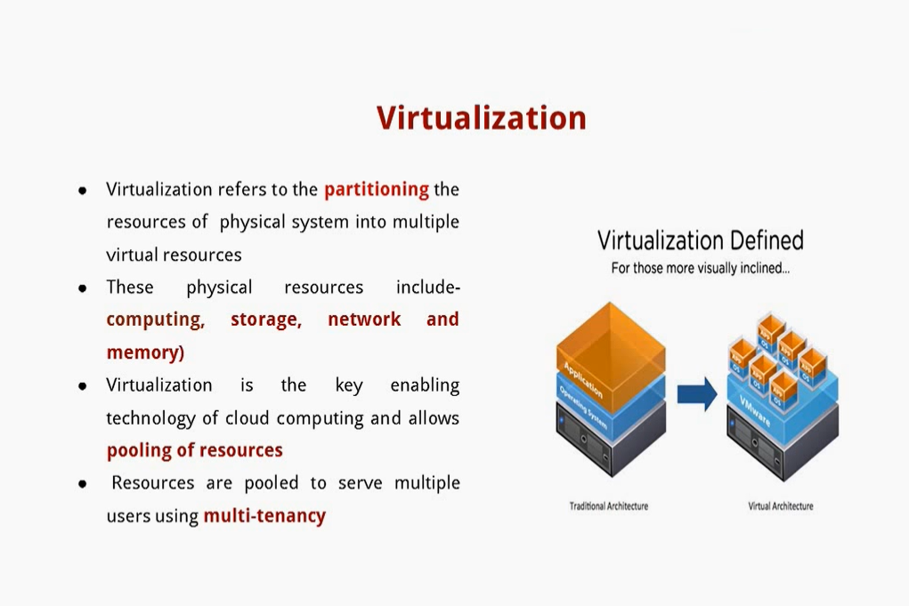

Slide 3
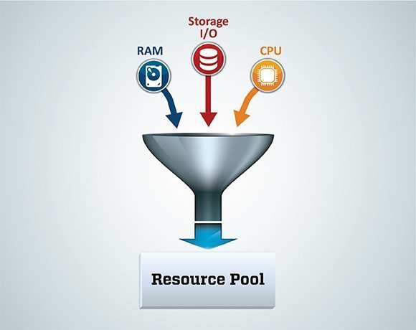
Resource pooling is the one of the essential attributes of Cloud Computing technology which separates cloud computing approach from the traditional IT approach. Resource pooling along with virtualization and sharing of resources, leads to dynamic behavior of the cloud.

Slide 4
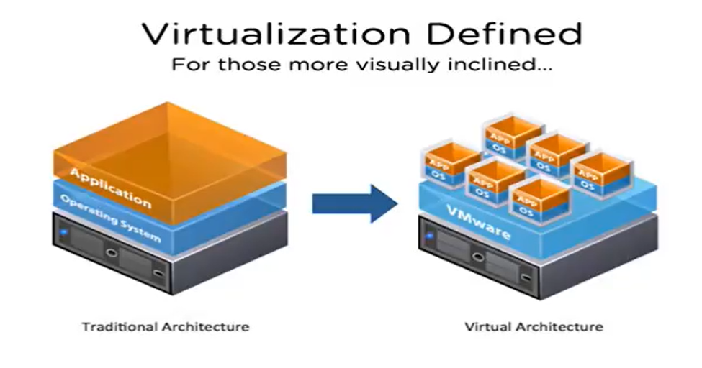
So Virtualization means
Virtualization means separation of physical resources form the end users. When an user ask for the request then portion of the hard disk or portion of the server are given to him.
This kind of creation of non giving you the actual physical server but giving you the portion of server is called virtualization.

Slide 5
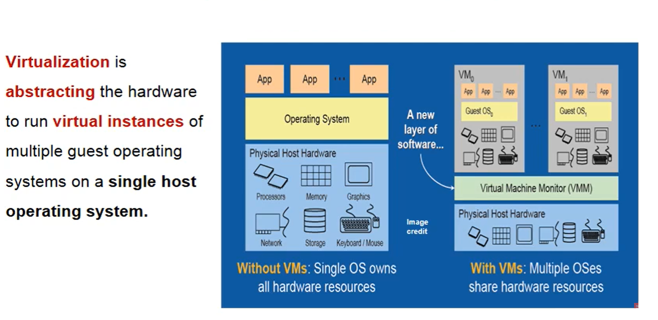
Virtualization Applied

Slide 6
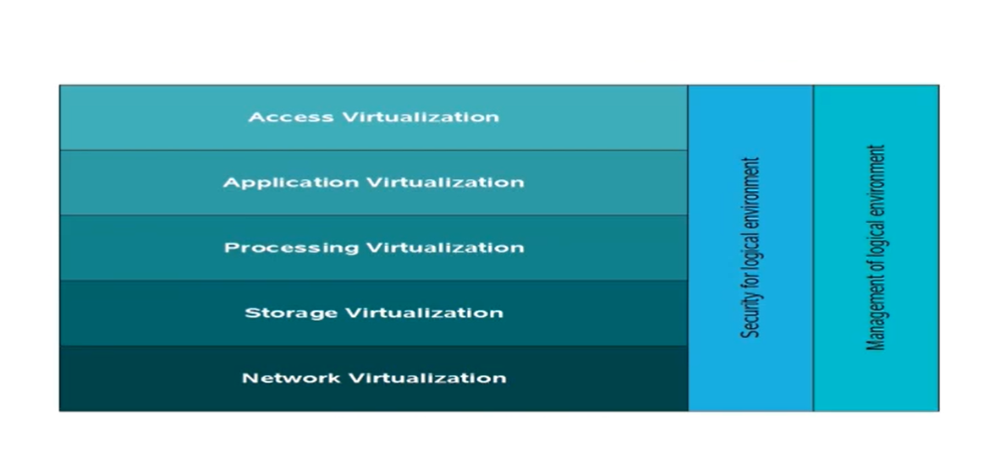
Virtualization Forms

Slide 7
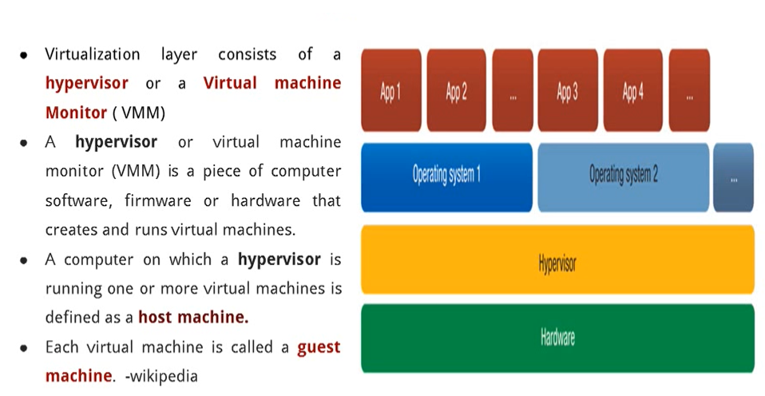
Hypervisor

Slide 8
Types of Hypervisors
There are two type of hypervisors
Type-1 (Bare Metal) Support Server based virtualization
Type- 2 (For Personal Computer)

Slide 9
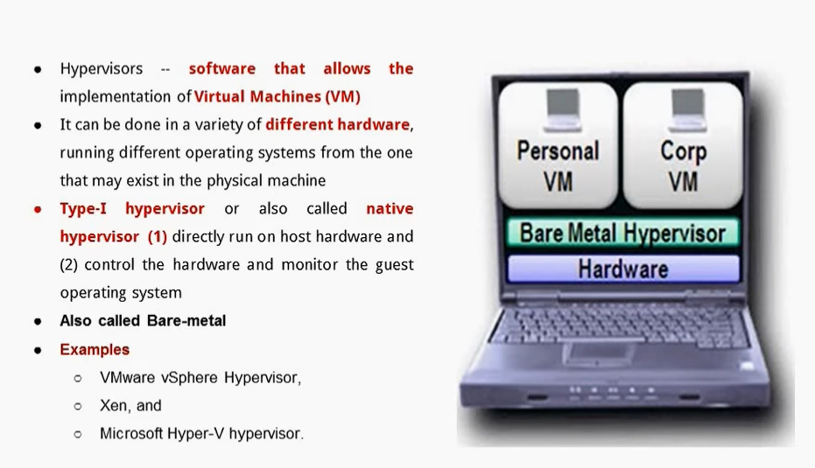
Type-1 Hypervisor (Bare-Metal)

Slide 10
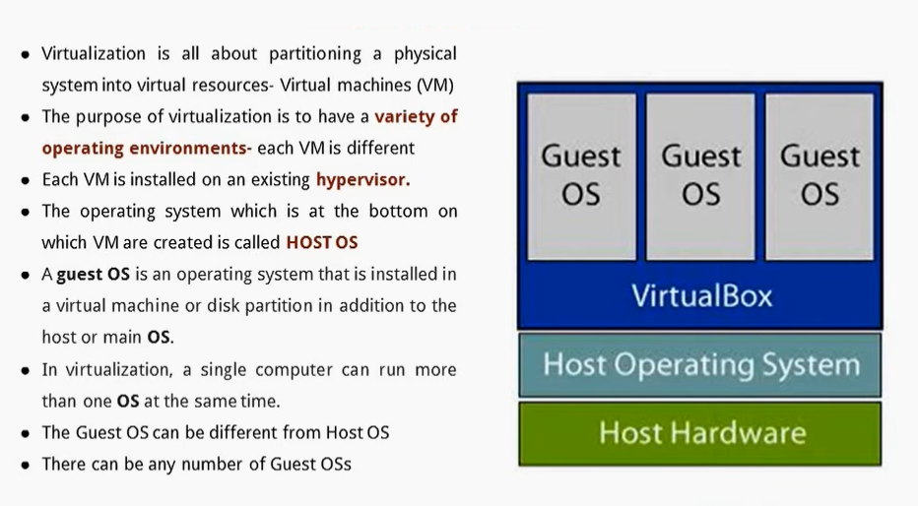
Type-2 Hypervisor

Slide 11
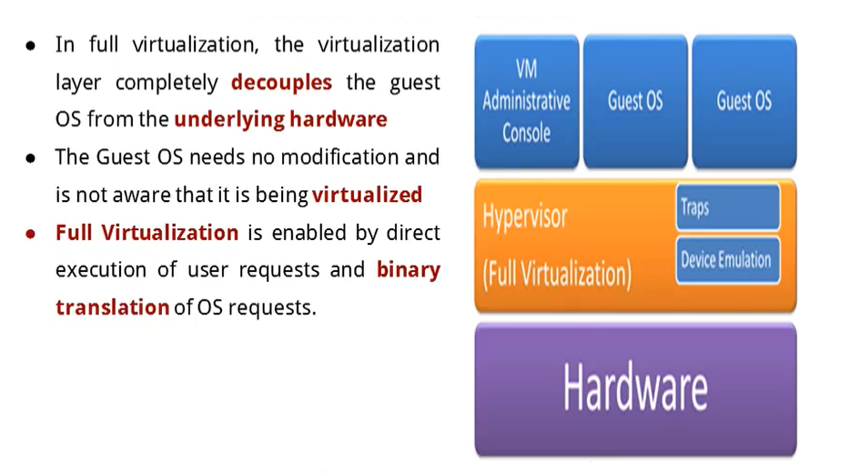
Full Virtualization

Slide 12
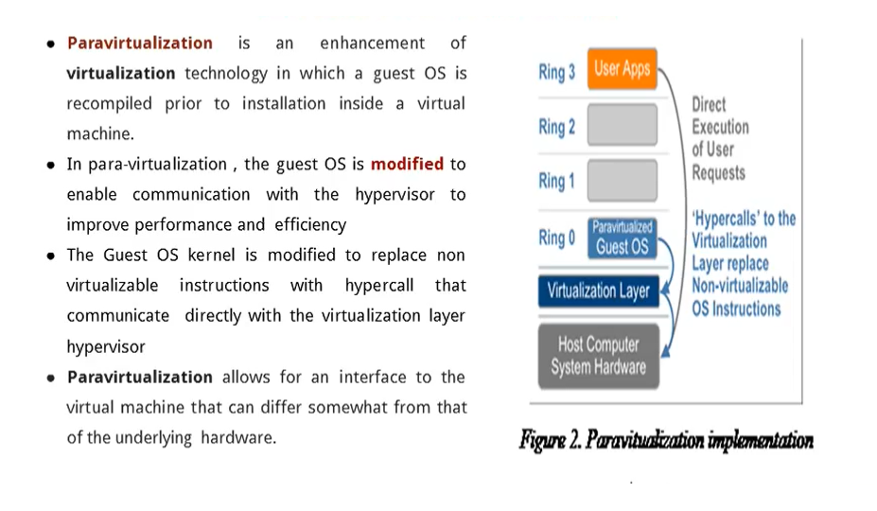
Para Virtualization

Slide 13
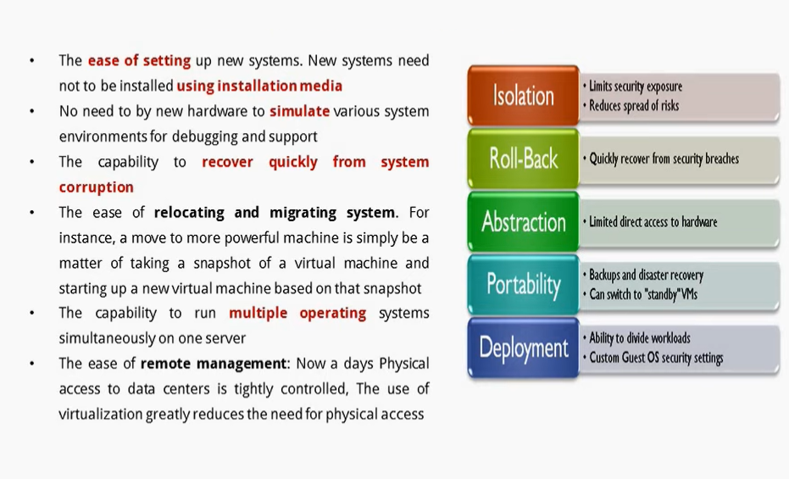
Virtualization Benefits

Slide 14
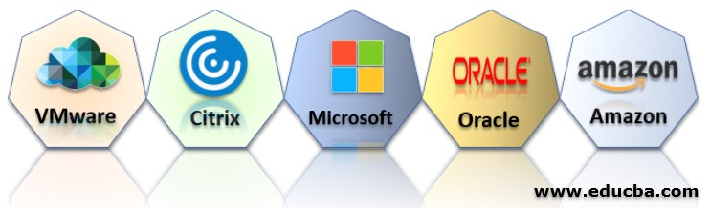
Top 5 Virtualization Vendors Platform

Slide 15
For more information visit the below link
https://www.vmware.com/content/dam/digitalmarketing/vmware/en/pdf/techpaper/VMware_paravirtualization.pdf

